Slide 1


ECEN 403 Status Update Presentation
RADIAN - RADar Intelligent Activity moNitoring Presented by: Matthew Blackwell, Wyatt Johnson, Mitch Hoffman
TA: Roman Venegas
Sponsor: Dr. Arya Menon

Slide 2

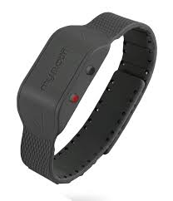
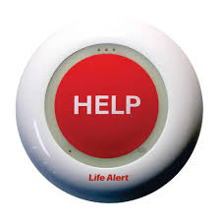
Problem Statement
Falls are the leading cause of injury in elderly
Fast detection saves lives through quick response
Current Solutions - Limitations:
Wearables → must be worn and charged
Push-buttons → user must be conscious/able to press
Camera → effective but invade privacy

Slide 3
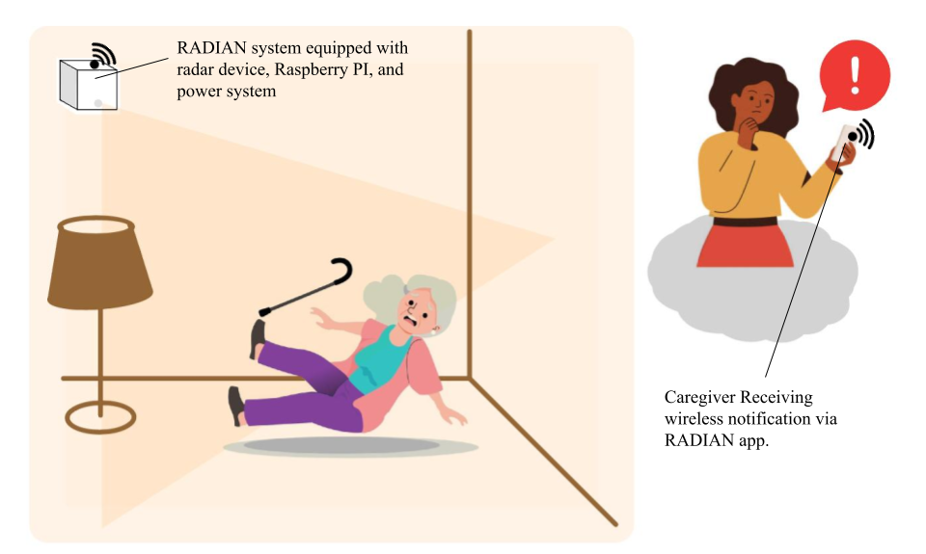
RADIAN System Summary
Proposed Solution:
Automatic Fall Detection
Works in real time
No user action needed
Privacy-Preserving
No camera
Protects independence
Reliable Response
Immediate accurate alerts to caregivers

Slide 4
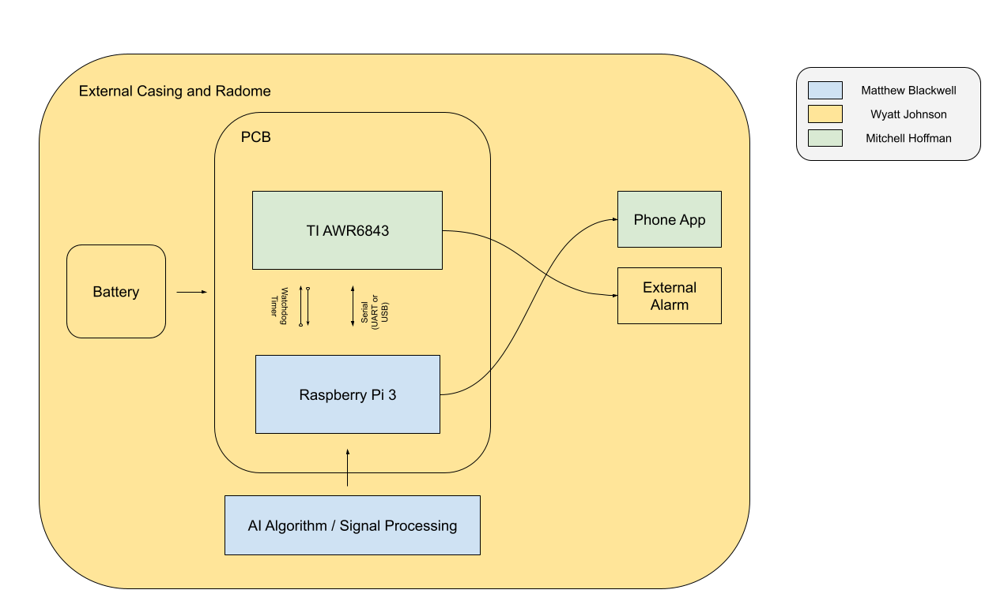
System Overview

Slide 5
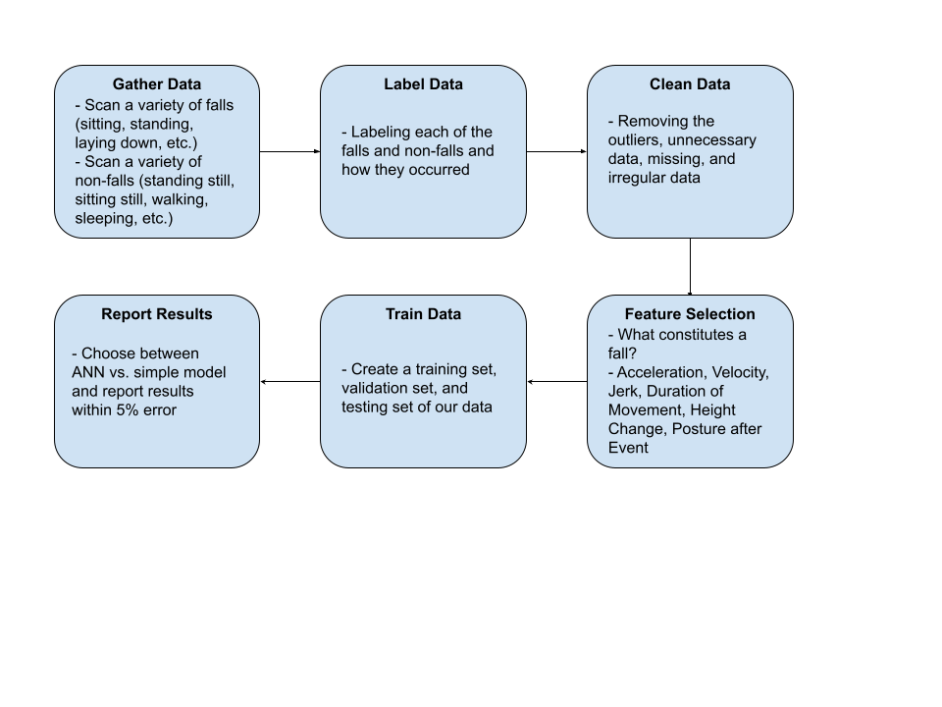
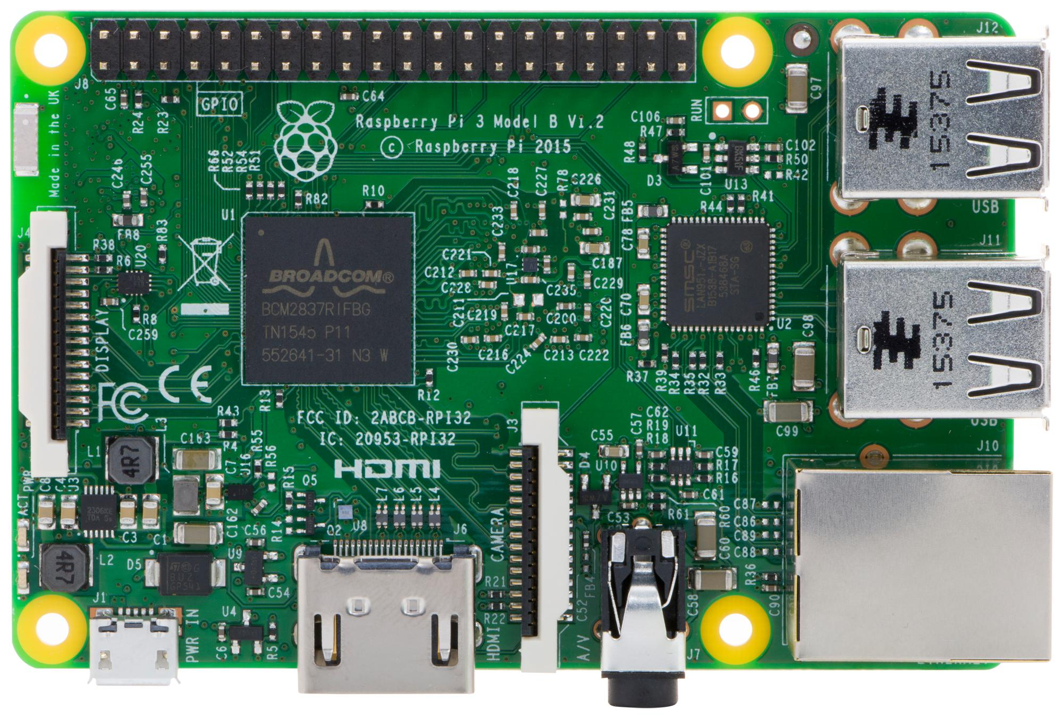
Data - Matthew Blackwell
Subsystem Function:
Provide an accurate ML model for determining if a fall occurred
Design Overview:
Raspberry Pi 3
Python
Scikit & Panda
Constraints:
Number of data tests
Compatibility with TI Board
ANN vs. Simple ML model

Slide 6
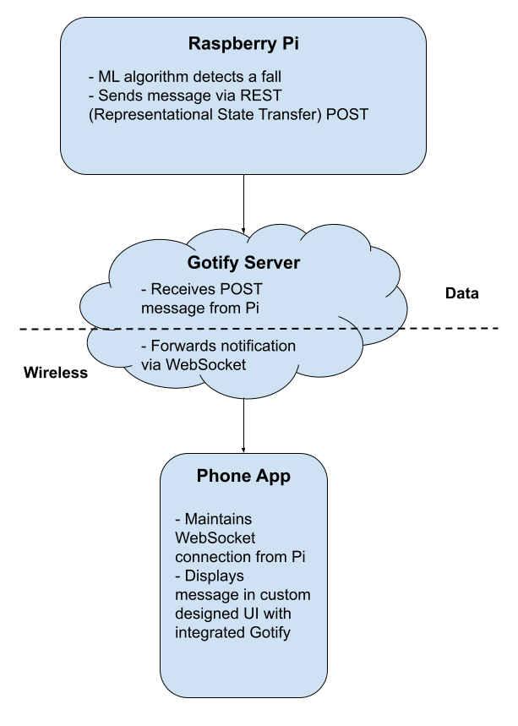

Data - Matthew Blackwell
Subsystem Function:
Design and create a Python script
to send message to Gotify server
Design Overview:
Raspberry Pi 3
Gotify to send Push Notifications
Constraints:
Integration with the TI Board

Slide 7
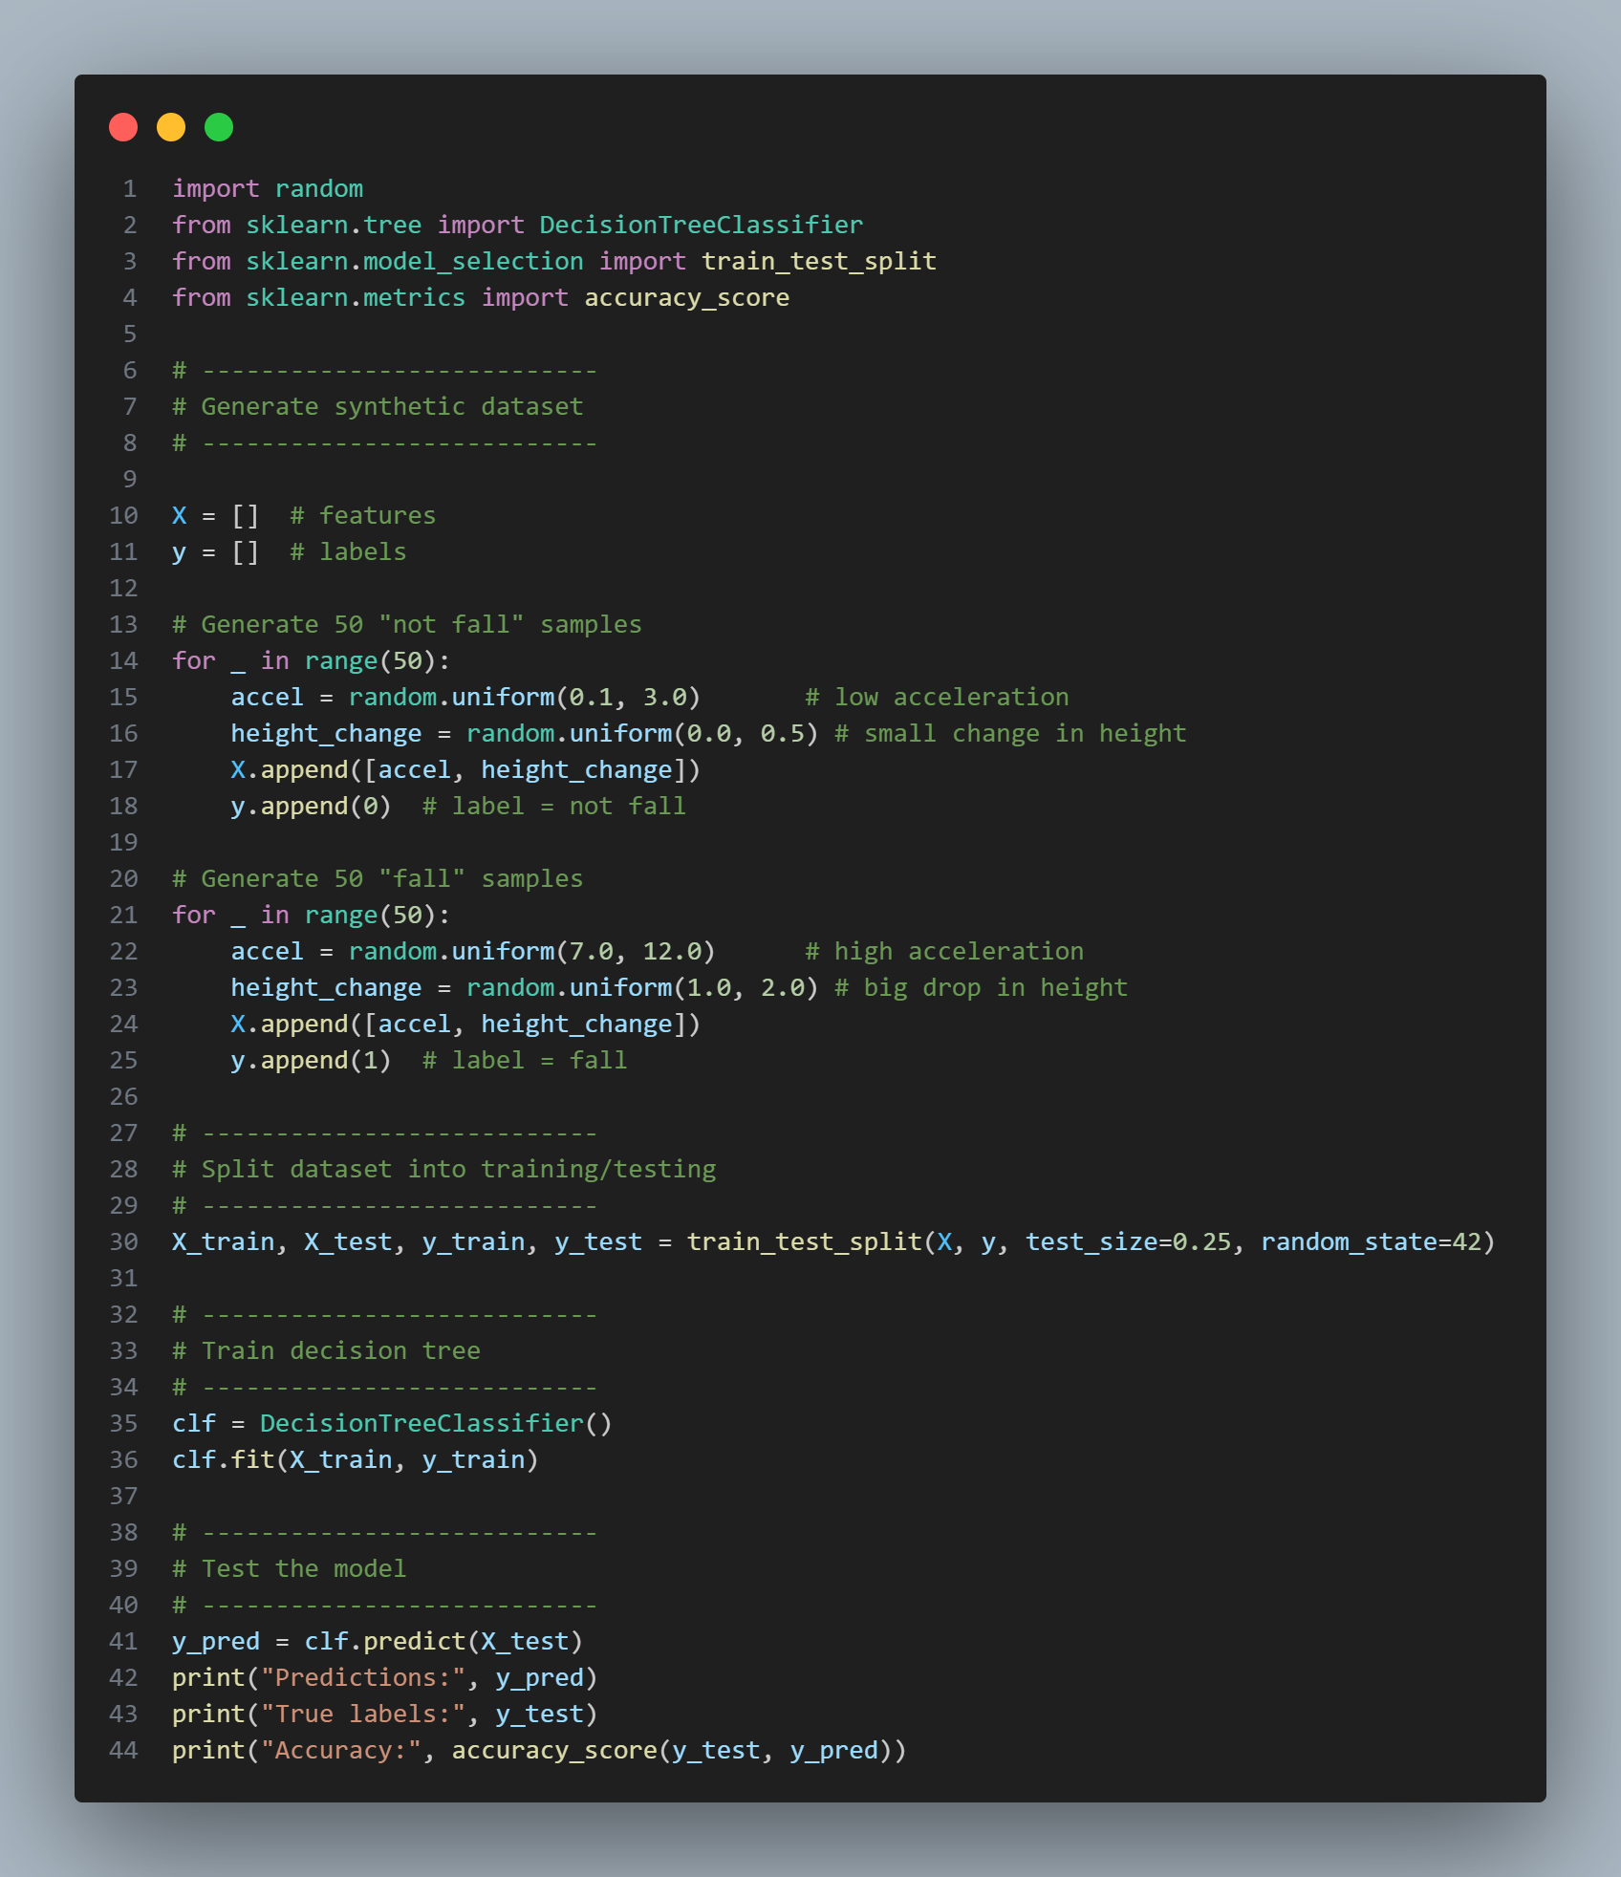
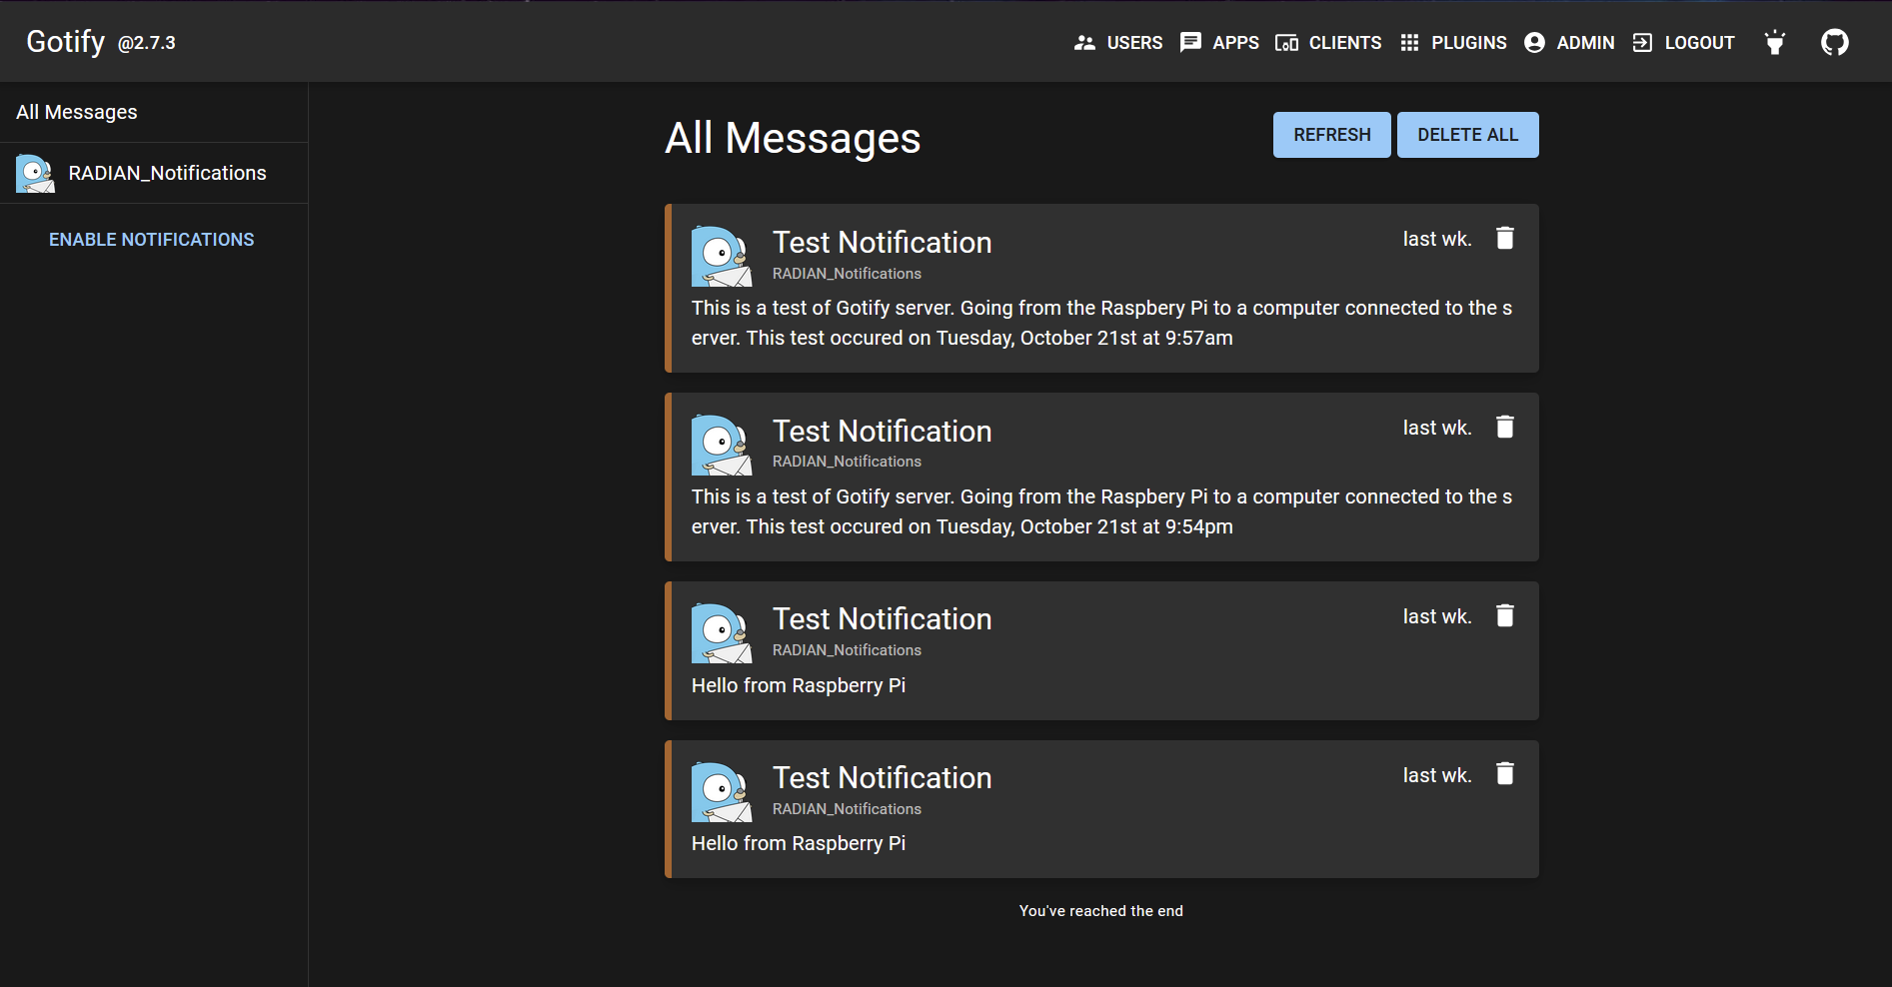
Accomplishments for Data System
Matthew Blackwell

Slide 8
Setbacks for Data System
Matthew Blackwell
Integration:
When attempting to integrate TI AWR6843, I fried our current Raspberry Pi
A backflow of current caused the 3.3V rail to fail, preventing the board from ever booting again
Raspberry Pi OS:
With my attempts of recovering the Pi, I reflashed the Raspberry Pi SD card and thus, lost all of my files saved on the card

Slide 9
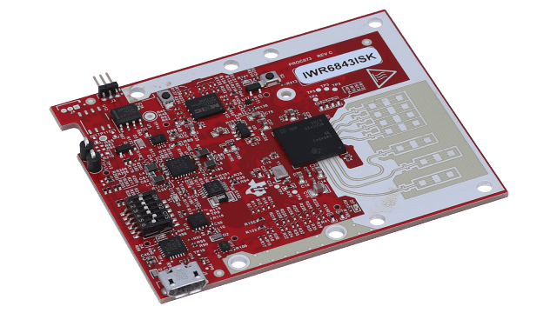
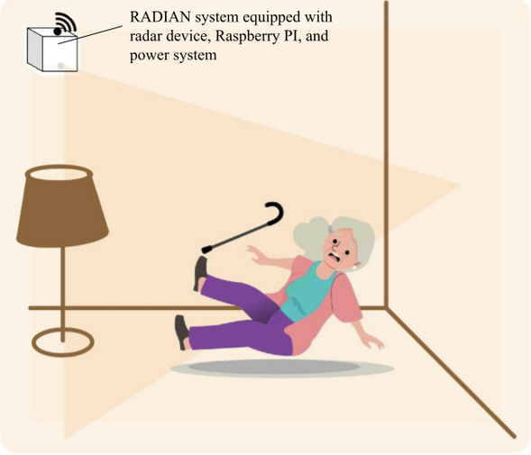
Ongoing work/Next steps for Data System
Matthew Blackwell

Slide 10
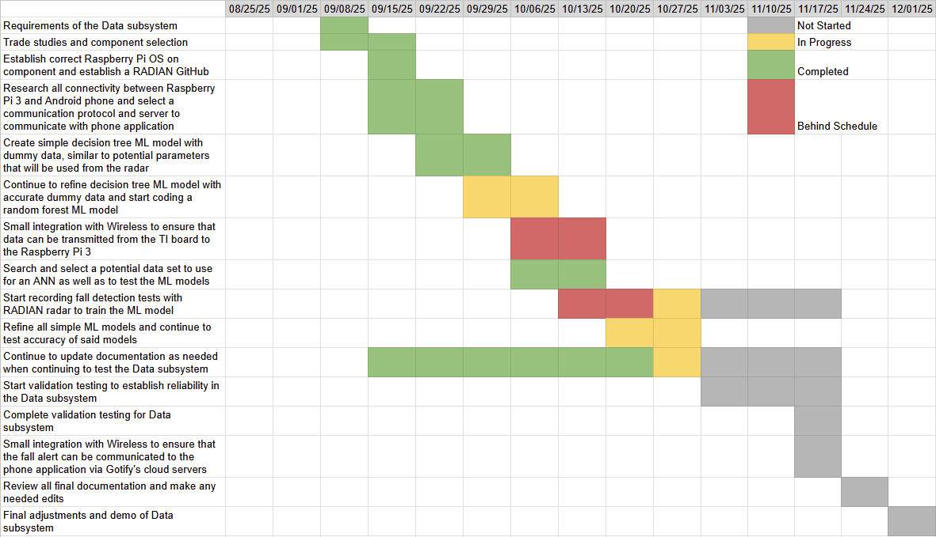
Data Execution plan

Slide 11
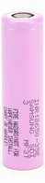
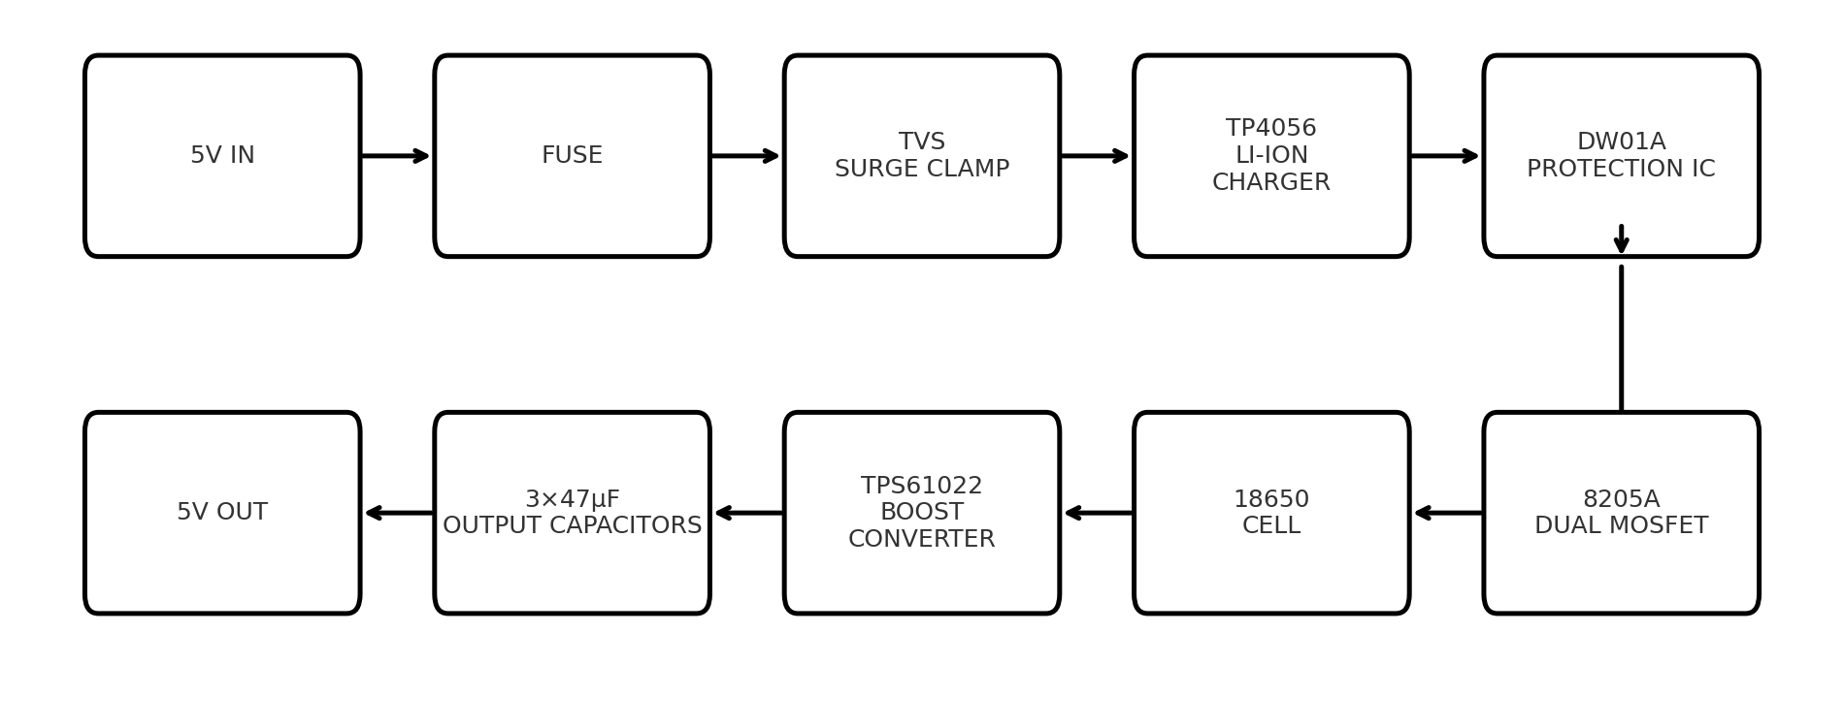
Physical – Wyatt Johnson
Power & Battery Subsystem:
Subsystem function:
Provide power, battery protection, and charging
Design Overview:
MCU/Control
Batteries
Power conversion
Cadence
Constraints:
Battery Safety
Thermal management
Interface compatibility
3.7v 3500mAh

Slide 12
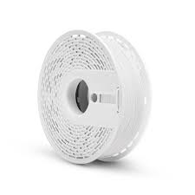
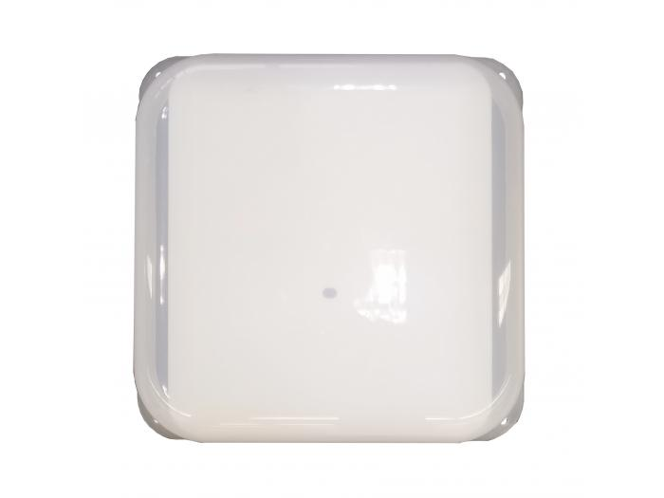

Radome:
Subsystem function:
Provide a visually appealing cover with minimal effect to radar signal.
Design Overview:
Housing made with 3D printer
Proper mounting and alignment over system

Slide 13
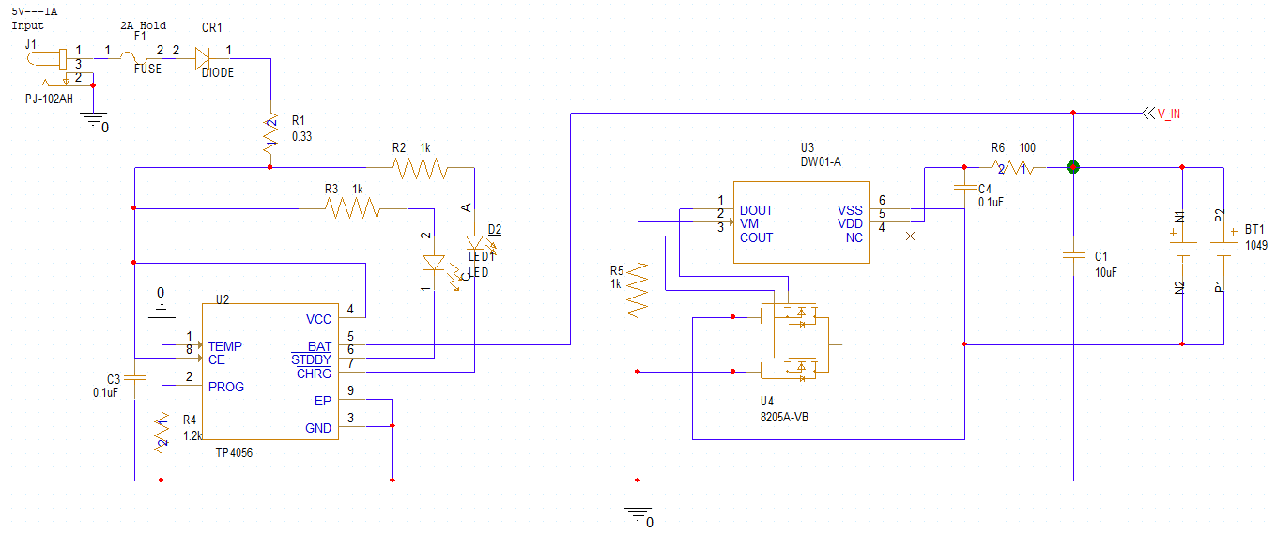
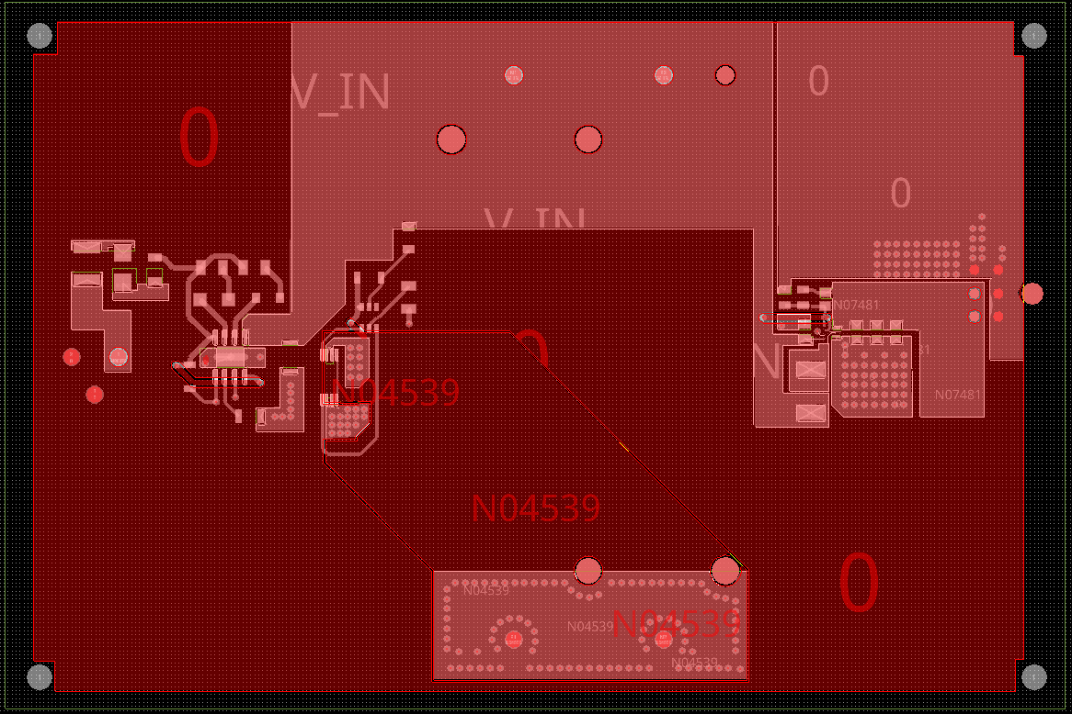
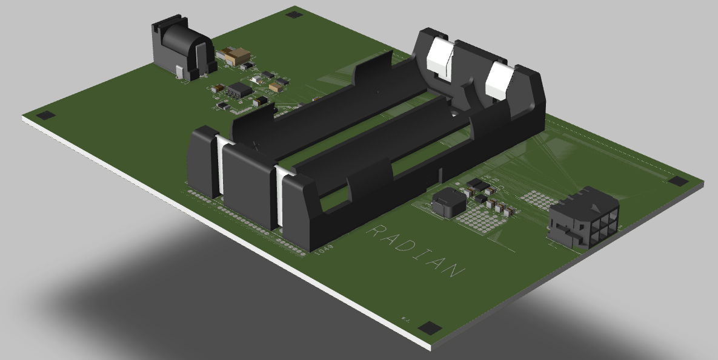
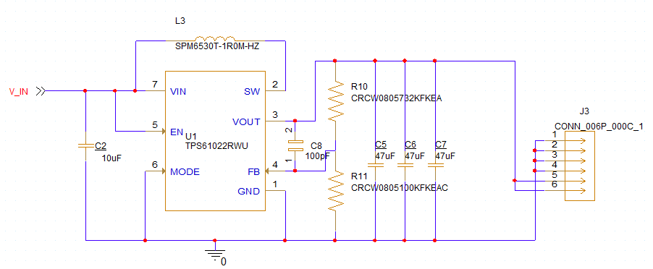
Accomplishments for Power System
Wyatt Johnson

Slide 14
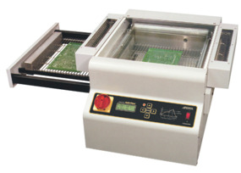
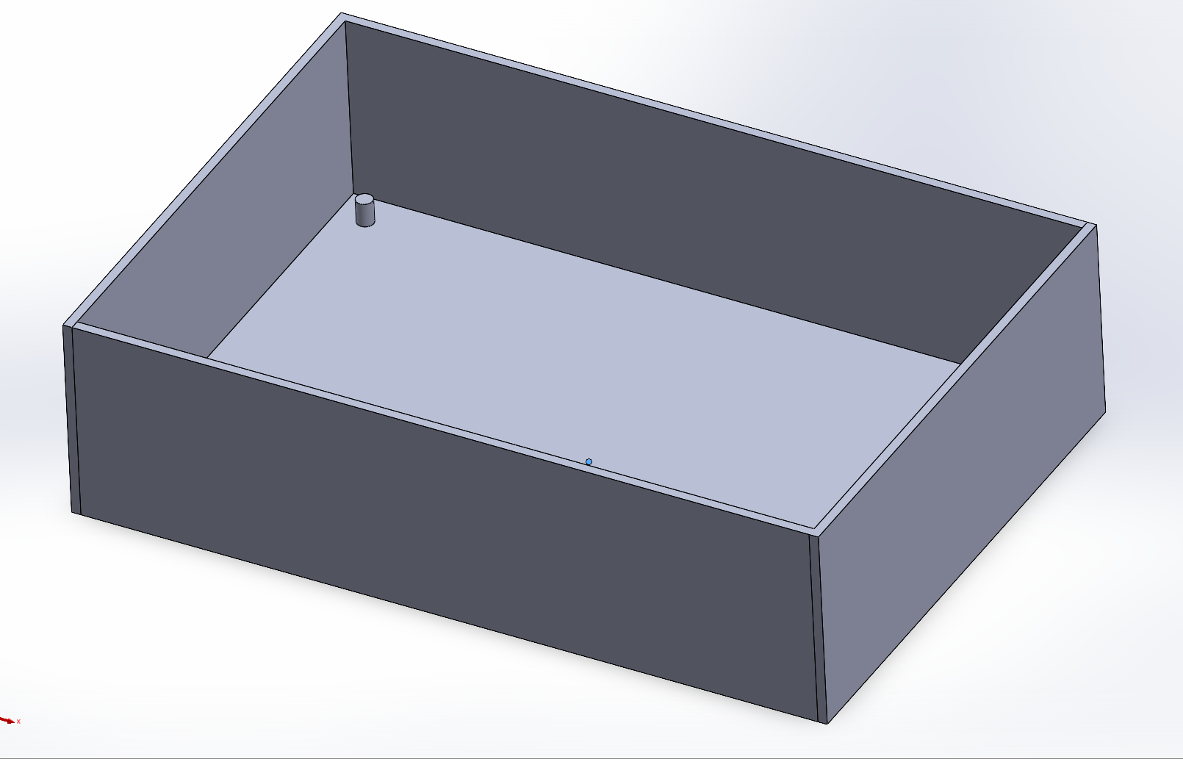
Ongoing work/Next steps for Power System
Wyatt Johnson

Slide 15
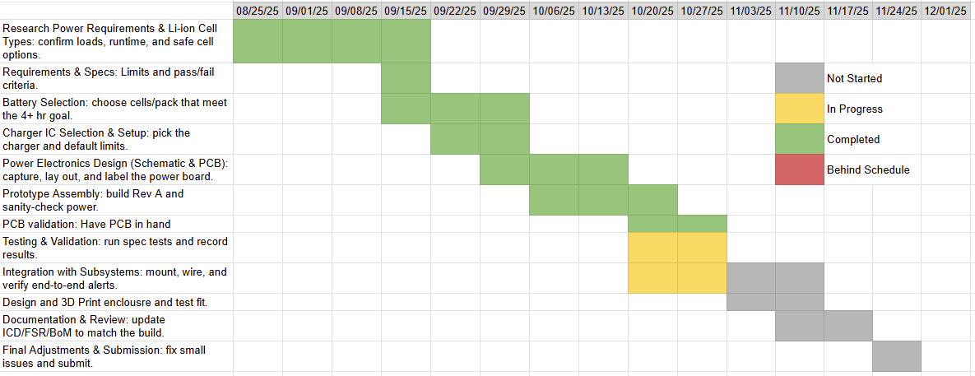
Physical Execution plan

Slide 16
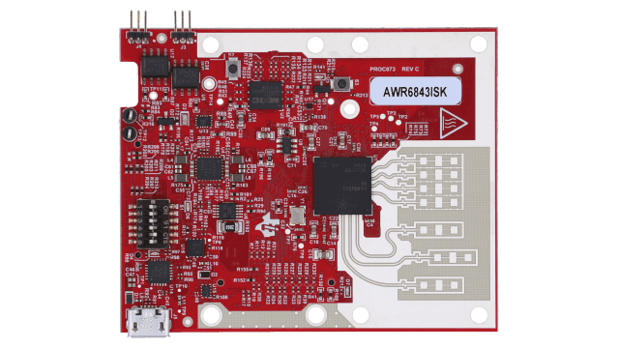
Wireless – Mitch Hoffman
Radar (AWR6843ISK)
Subsystem Function:
Processes motion data from radar and sends to Pi for fall detection
Design Overview:
AWR6843ISK
VS Code
Python
Raspberry Pi 3
Mobile App

Slide 17
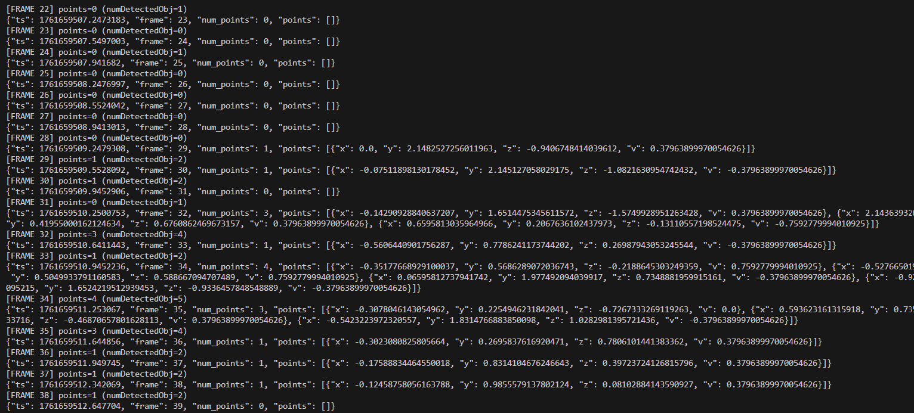
Accomplishments/Next steps for Radar
Mitch Hoffman
Accomplishments:
-Radar data output in terminal
-Using TI radar configuration code along with my own code to output point cloud data (x, y, z, v)
Next Steps: –Integrate with Pi to start testing

Slide 18
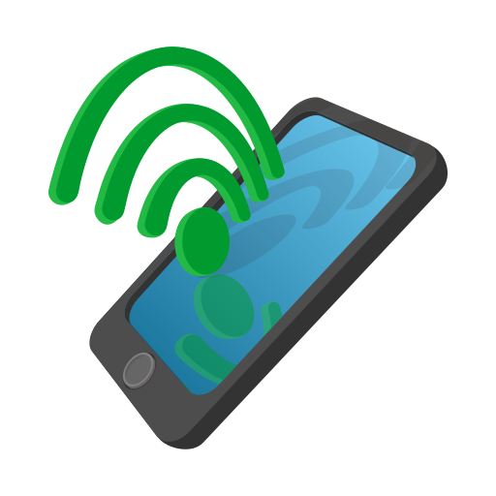
Wireless – Mitch Hoffman
Raspberry Pi 3
Subsystem Function:
Pi transmits fall alerts via Wifi to the cloud then to a mobile app for user notification
Design Overview:
Flutter (Dart)
Android Studio
Cloud
Mobile App

Slide 19
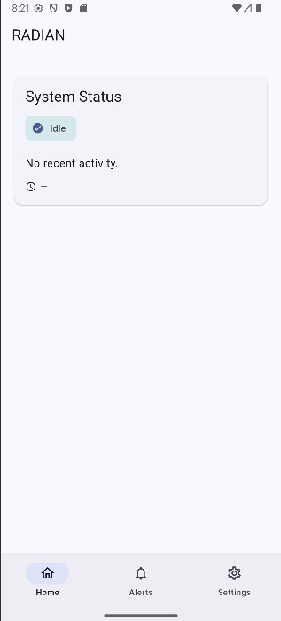
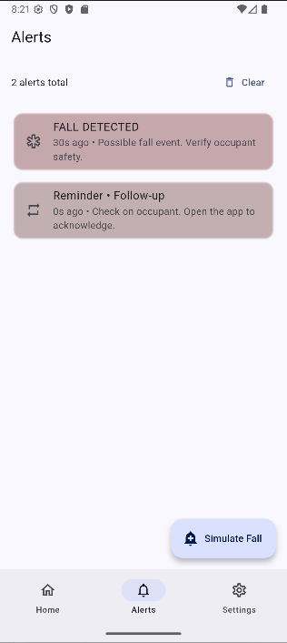
Accomplishments/Next steps for App
Mitch Hoffman
Accomplishments:
-Basic app UI
-Simulate alert notifications
Next Steps: -Have code be able to connect to Gotify Server
-Start testing alerts from Gotify Server

Slide 20
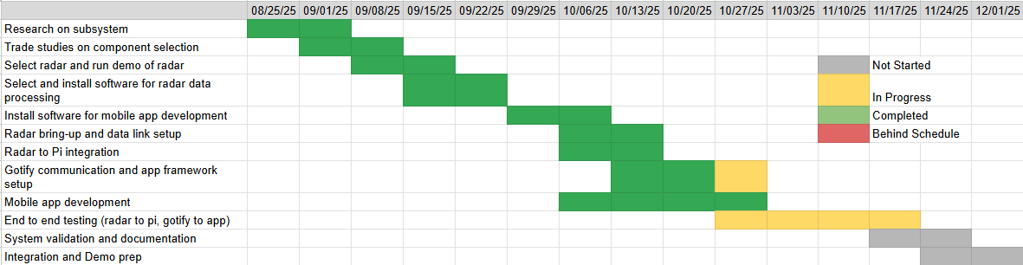
Wireless Execution plan

Slide 21
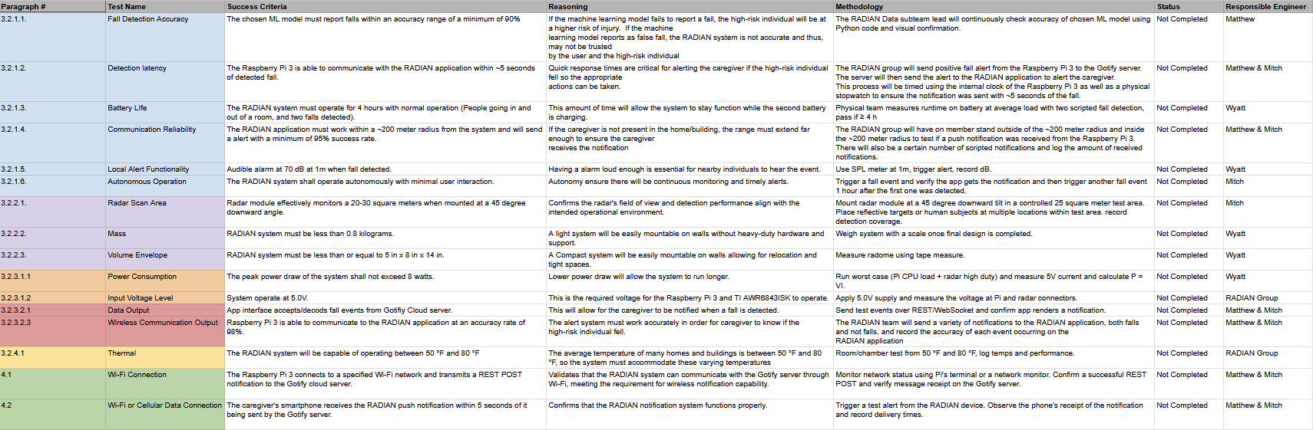
Validation plan

Slide 22
Questions?

